Slide 1
Design Sessional Project
Residential Tower located in Noida
Spring Semester 2024
Group 11

Slide 2
Group Members
21CE10062 Shameek Saha
21CE10063 Shivangi
21CE10064 Shivshankar Yadav
21CE10065 Shubhangi Singh
21CE10066 Somshubhra Ghosh
21CE30025 Rudra Sai Teja
21CE30026 Sachin Kumar Repswal

Slide 3
Design Basis Report
Problem Statement
Number of floors: B+G+22
Location of the building: Noida
Number of apartments in a floor: 4
Area of each apartment: 141.6 ㎡
Height of the Basement and Ground floor: 2.7 m
Height of the each floor: 3.1 m
Boundary wall thickness:0.35
Exterior wall thickness: 0.28 m
Interior wall thickness: 0.20 m
Bearing Capacity: 14 ton/㎡

Slide 4
Materials Considered
M30 Grade concrete for RCC Structural elements
❑ Fe500 Steel for RCC Structural elements
❑ Fe410 Steel for all Steel members

Slide 5
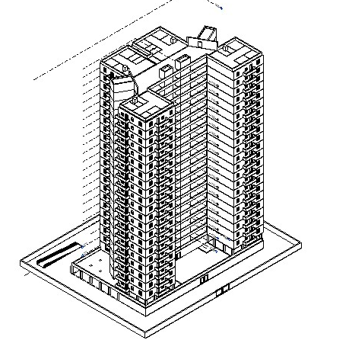
Isometric View

Slide 6
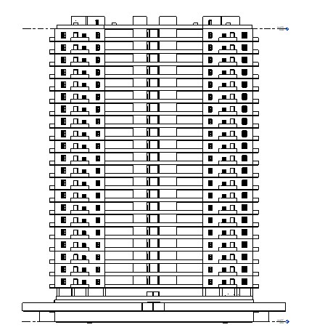
Front View

Slide 7
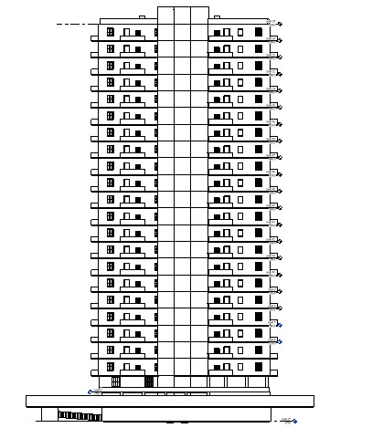
Side View

Slide 8
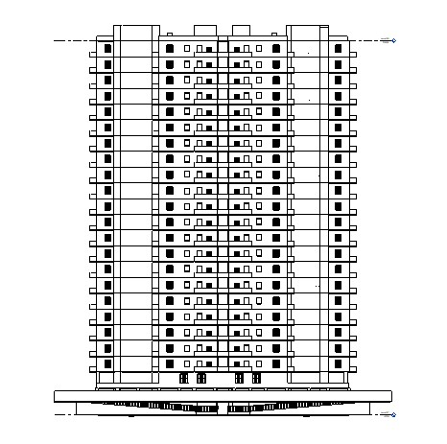
Back View

Slide 9
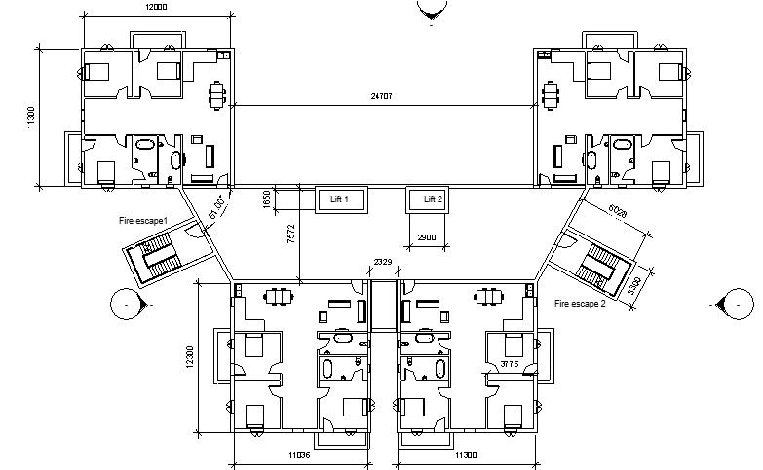
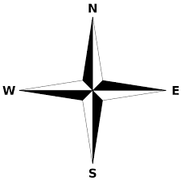
Floor Plan

Slide 10
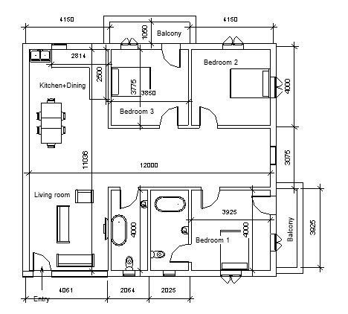
Plan View of an Apartment

Slide 11
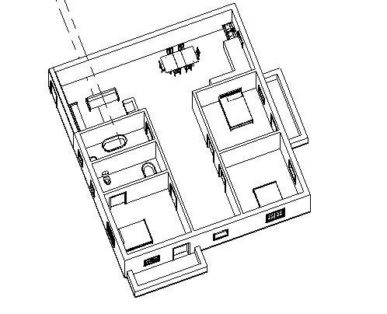
3D view of an Apartment

Slide 12
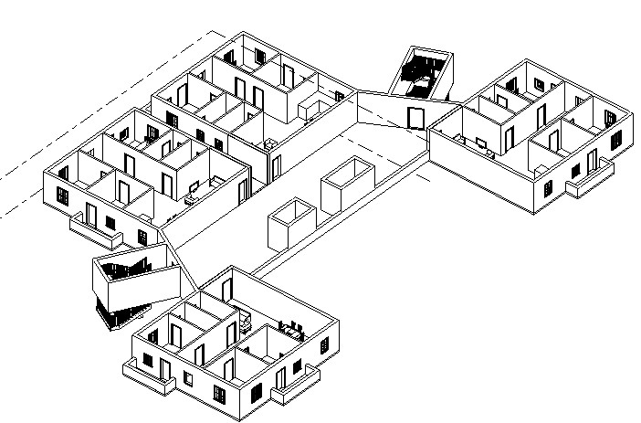
3D view of a Typical Floor

Slide 13
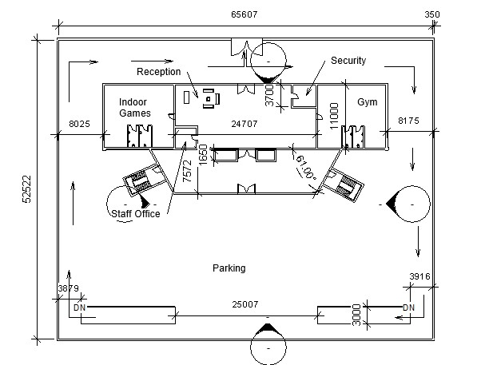
Ground Floor Plan

Slide 14
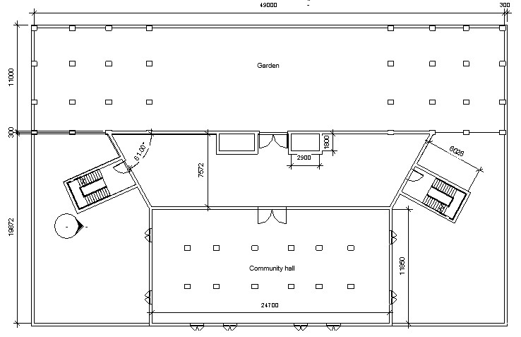
First Floor Plan

Slide 15
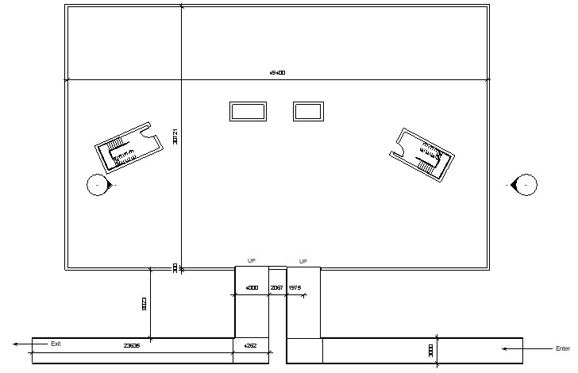
Basement Plan

Slide 16
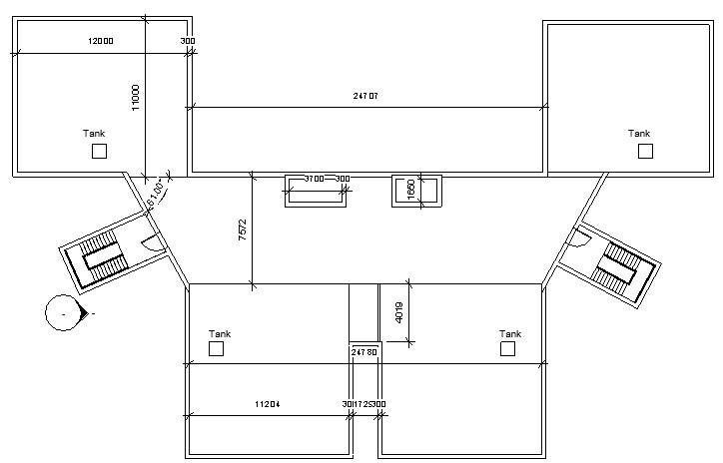
Roof Plan

Slide 17
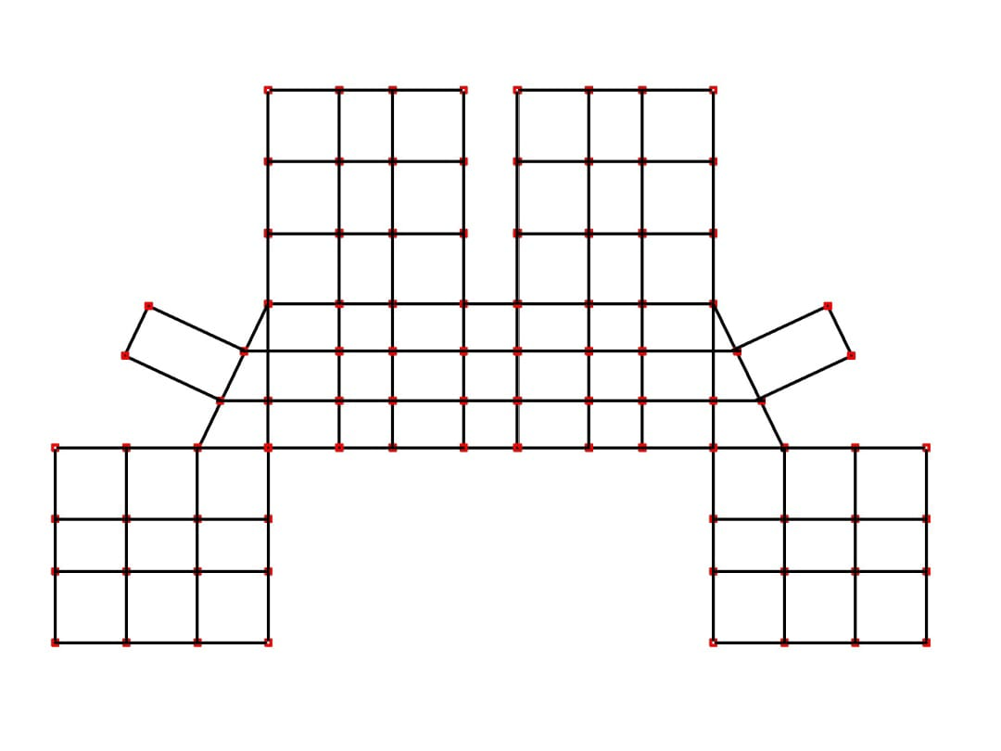
Beam Column Layout

Slide 18
Merits of Our Plan
1. For each apartment there is at least one bedroom which faces south.
2. The bathrooms are kept in the inner sides for appropriate plumbing layout.
3. The kitchen is designed as an open kitchen.
4. Enough ventilation is provided in each room and the corridor will get enough sunlight.
5. The tower is constructed on a podium and the top of the podium is made into a garden.
6. The open areas in the floors will receive enough sunlight and ventilation.
7. In an apartment block the columns are placed in a symmetrical manner.

Slide 19
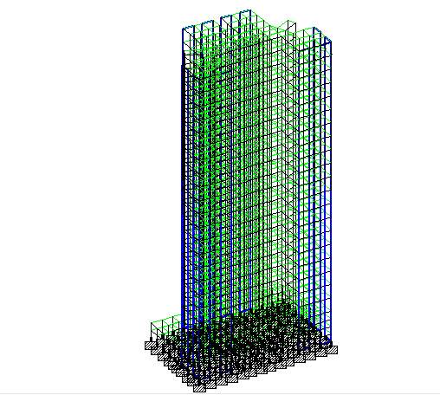
Staad Model

Slide 20
All Loads Calculations
(DL+LL+WL+SL)

Slide 21
Dead Load
LOAD DEFINITION AND VALUES AS PER IS:875 PART 1

Slide 22
Parameters used from IS 875 Part 1
Dead Load | Value
Self weight Factor | -1
Slab | 3.75KN/m^2
Exterior wall | 16.464KN/m
Interior wall | 11.76KN/m
Parapet wall | 6.1152KN/m
Floor finish | 1KN/m^2
Roof finish | 0.5KN/m^2
Water tank load | 22KN/m^2

Slide 23
Live Load
LOAD DEFINITION AND VALUES AS PER IS:875 PART 2

Slide 24
Parameters used from IS 875 Part 2
Live Load | Value(KN/m^2)
Bedroom | 2
Toilet & Bathroom | 2
Kitchen | 2
Dining cum Living Room | 3
Staircase | 3
Common Space | 3
Balcony | 3

Slide 25
Wind Pressure & Design
Forces
Reference: IS:875 PART 3

Slide 26
PARAMETERS USED FROM IS: 875 PT.3
Wind Data | Value | Reference
Basic wind speed(vb) | 47m/s | Figure 1, IS 875,part 3
Wind Zone | 4 | Figure 1, IS 875,part 3
Terrain category | 4 | IS 875,part 3, section 5.3.2.1

Slide 27
PARAMETERS USED FROM IS: 875 PT.3
Design Factors | Value | Reference
Risk Coefficient Factor, k1 | 1 | Table 1 IS 875 Part 3
Terrain & Height Factor,k2 | Varies with height
Topography Factor, k3 | 1 | Clause 5.3.3.1 IS 875 Part3

Slide 28
PARAMETERS USED FROM IS: 875 PT.3
Design wind parameters | Value | Reference
Design Wind Speed Vz=Vb*k1*k2*k3 | 47k2 | Clause 5.3 IS 875 Part3
Pz = 0.6(Vz ) ^2 | 1325.4k2^2 | Clause 5.4 IS 875 Part3

Slide 29
PARAMETERS USED FROM IS: 875 PT.3
Height m | k2 | Pz (kN/m2)
10 | 0.8 | 0.848
15 | 0.8 | 0.848
20 | 0.8 | 0.848
30 | 0.97 | 1.247
50 | 1.1 | 1.604

Slide 30
Earthquake Load
Reference IS:1893

Slide 31
Seismic Load (Reference- IS:1893)
Seismic Parameter | Value
Zone | 4
zone factor | 0.24
Importance factor | 1
Response reduction factor | 5
Structure Type | RC Frame Building
Seismic load in X and Z directions

Slide 32
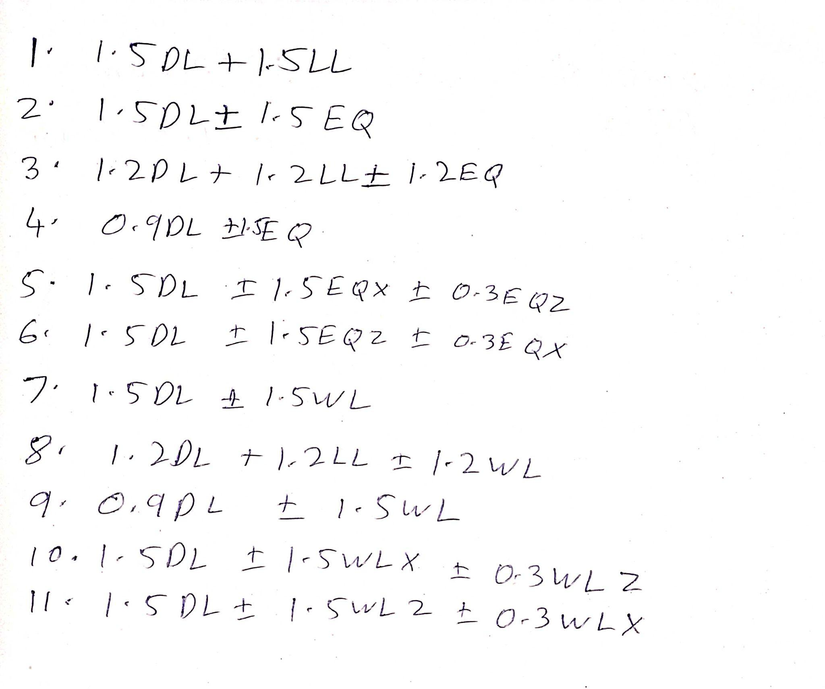
Load combination (IS:456)

Slide 33
Plumbing (Manual)
Total Number of floors=21
Number of units on each floor = 4
Average number of members per family = 6
Total population= 21*4*6=504~500
Water required as per NBC 2016 = 150 Lpcd
Assuming FOS as 1.2
Total Water required= 150*500*1.2 = 90,000Lpd
Average 8hr pumping rate = 90000/8 = 11,250L
Average hourly demand= 90000/24 = 3750L
Considering Pumping hours from 6 am to 10 am and 2 pm to 6 pm
Storage capacity= max deficit + max surplus
= 11437.5+14250 = 25687.5L
Storage capacity as per table 16 SP35
Storage capacity= population *70L
= 35000

Slide 34
Plumbing (Manual)
Time From (h) | Time To (h) |  | Demand in the given period(L) | Cumulative Demand(L) | Pumping done in a given period(L) | Cumulative pumping(L) | Cumulative deficit or Surplus(L)
0 | 4 | 0.8 | 3000 | 3000 | 0 | 0 | -3000
4 | 5 | 0.4 | 1500 | 4500 | 0 | 0 | -4500
5 | 6 | 0.8 | 3000 | 7500 | 0 | 0 | -7500
6 | 10 | 9 | 33750 | 41250 | 45000 | 45000 | 3750
10 | 12 | 2 | 7500 | 48750 | 0 | 45000 | -3750
12 | 13 | 0.6 | 2250 | 51000 | 0 | 45000 | -6000
13 | 14 | 2.25 | 8437.5 | 59437.5 | 0 | 45000 | -14437.5
14 | 17 | 2.1 | 7875 | 67312.5 | 33750 | 78750 | 11437.5
17 | 18 | 2.25 | 8437.5 | 75750 | 11250 | 90000 | 14250
18 | 20 | 1.8 | 6750 | 82500 | 0 | 90000 | 7500
20 | 22 | 1.4 | 5250 | 87750 | 0 | 90000 | 2250
22 | 23 | 0.4 | 1500 | 89250 | 0 | 90000 | 750
23 | 24 | 0.2 | 750 | 90000 | 0 | 90000 | 0

Slide 35
Plumbing (Manual)
As per clause 5.4.2.3 of SP35
Storage capacity=Number of apartments x 270+(Total number of Bathrooms-Number of Apartments) x 180
= 84*270+(168-84)*180
=37800L
As per clause 5.4.2.3 of SP35
Maximum Storage capacity= 0.5*Daily water supply
= 0.5*90000
=45000
Storage of Overload tank=Max(25687.5, 35000,37800,45000)=45000L
Assuming 4 circular tanks of radius 1.2 m and height 2.5m
The sanitary fixtures in each apartment consist of the following:
a) 1 sink and 1 tap in the kitchen
b) 1 overhead flushing tank for the water closet and tap in each water closet room;
c) 2 showers, and 2 wash basins and taps; and
d) 1 mini geyser in each bathroom.

Slide 36
Plumbing (Manual)
Supply System
In the downtake supply or downfeed distribution, the supply from the street main is drawn into a ground level storage tank wherefrom the supply is again pumped to an overhead storage tank and then the supply is drawn by gravity.
Sewage system Design
Two Pipe System
In this system of plumbing, the soil and the waste pipes are distinct and separate, the soil pipes being connected to the building drain directly, and the waste pipes connected to the building drain through a trapped gulley.
All traps of soil appliances are completely ventilated through a separate ventilating pipe. Likewise, traps of all waste appliances are also completely ventilated through a separate ventilating pipe. Thus it contains one soil pipe, one waste pipe and two ventilating pipes.
The vent pipe is installed to provide a flow of air to or from a drainage system or to provide circulation of air within such system to provide protect trap seals from siphonage and backflow. The system consists of one main ventilating pipe (MVP) to which branch vent pipes (BVP) of each storey are connected. The MVP provides a safe outlet for the foul gases in the drain or sewer into the atmosphere.

Slide 37
Plumbing (Manual)
A Two-pipe system will be provided in the residential blocks for disposal of sewage where soil pipes are connected to the building drain direct and the waste pipes are connected to the building –drain using a rapped gulley.
A Main ventilation pipe (MVP) is provided for the main waste pipes (MWP) and the main soil pipe (MSP).
1. Waste Appliances(Internal diameters) (Table54ofSP 35)
Waste Appliances | Internal Diameter
Wash Basin | 30mm
Bathrooms | 40mm
Water Closet | 50mm

Slide 38
Plumbing (Manual)
2. Horizontal branches for each floor(diameters) (Table 52 of SP35)
Floor | MWP | MSP
All Floors | 100mm | 100mm
MWP and MSP columns indicate the diameter of the horizontal branches joining MWP and MSP respectively.
MWP and MSP(Table 53 of SP 35)
The diameter provided for all the MWP and MSP is 150mm.
MVP(Main ventilation pipe) (Clause 6.7.5.3ofSP 35)
The diameter provided for the MVP is 50mm.

Slide 39
Plumbing (Manual)
We have the total water demand calculated in the previous section 90,000L/day
• Now assume 90% of total consumption to reach the sewer
• Here, peak factor=3(since population <20,000)
• ➢Total storage= 90,000*0.9*3 L/day
• = 2812.5 cm^3/s
• Now using Mannings’ formula Q=AR^{2/3}√s/n
• Take slope of main sewer pipe= 1/1000
• Mannings’ coefficient= 0.012
• ➢2812.5 =πd2/4*(d/4)2/3*√(1/1000)*(1/0.012)
• => d= 21.15
• => Provide a 220 mm diameter pipe for the sewer pipe connecting the sewage from all the flats to the municipal sewage system.

Slide 40
Beam Design (Manual)
Beam Design
Length of beam = 4000 mm Size: 250 mm * 450 mm
Clear cover = 20 mm
Design for Flexure:
Maximum applied moment (Mu) = 66.04KN.m
Taking FOS as 1.5, Factored moment (Mu) = 66.04* 1.5 = 99.06 KN.m
For a balanced section:
Maximum bending moment = 0.133 * fck * b * d^2
= 0.133 * 30 * 250 * (450 - 20)^2 = 184.437 KN.m
Mu < 184.437 KN.m, so the beam is safe for design as an under-reinforced section
xu / d = 1.2 - (1.44 - (6.78Mu) / (fck * b* d2 )) ^ (½)
= 1.2 - 0.977 = 0.223
Therefore, percentage of steel required (p) = 41.38 * (fck / fy) * (xu / d)
= 0.55% (approx.)
So, the Area of steel required (Ast) = (p * b * d) / 100 = 618.75 mm^2
Hence provide 4 - 15 φ bars for reinforcement
Design for Shear:
Shear Force (V) = 31 KN
Shear stress (Tv) = V / bd = (31 * 10^3) / (250 * (450 - 20 - 15/2 - 10)) = 0.30 MPa

Slide 41
From Table 19 of IS: 456 - 2000:
Design Shear Strength (Tc) = 0.518 MPa (For M30 concrete and Ast = 618.75 mm^2)
Tv < Tc, so we design for minimum shear reinforcement
Using 2-legged 8 mm dia. stirrups, we have
Spacing between stirrups (Sv) = (0.87 * fy * Asv) / (b * 0.4)
= (0.87 * 500 * 2 * ℼ/4 * 8^2) / (300 * 0.4)
= 364.425 mm
However according to IS: 456 - 2000, the maximum spacing between stirrups should not
exceed 300 mm.
Therefore, provide 2-legged 8 φ stirrups @ 300 mm c/c as shear reinforcement

Slide 42
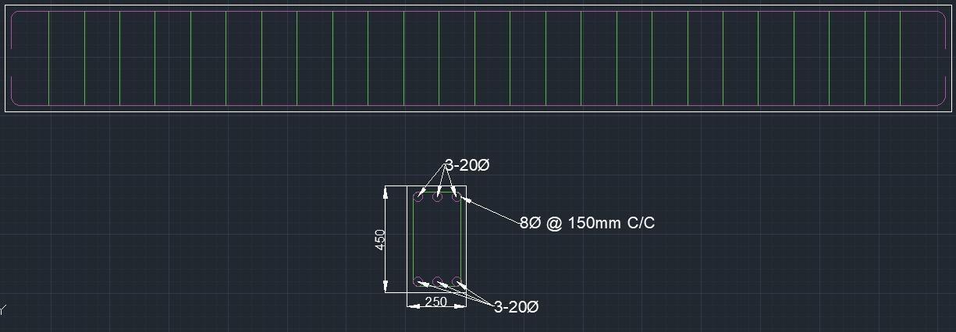
Beam Design (Manual)

Slide 43
Slab Design (Manual)
Slab Design(General Floor)
Raw dimensions of slab = 4m x 4m
Factored Load = 1.5*(1+3) = 6 kN
Span/Depth = 40 (as per IS 456-2000)
Depth of slab D = 150
Assuming a 10 mm dia bar and 15 mm clear cover
Effective Depth d= 150-15-10/2 = 130mm
Support thickness= 250
Both spans are equal hence two-way slab ( lx/ly=1)
Effective span= min(clear span+depth, clear span + c/c support) = 4130 mm
Moment Calculation
From Table 26 of 15456-2000
ɑx=0.062 ɑy=0.062
Mx = ɑx*w*lx² = 0.062*6*(4.13)² = 6.35kNm
My = ɑy*w*ly² = 0.062*6*(4.13)² = 6.35kNm

Slide 44
Slab Design (Manual)
Limiting Moment= 0.133*fck*b*d^2 = 0.133*30*1000*0.13^2 = 67.431 kNm
P_{t} = 50*fckfy*(1-1-4.6*Mufck*b*d2) = 0.0.0877
Ast = (0.0877×1000×130)/100 = 114.026 mm^2 (per unit width)
Using 10mm@ 500mm gives Ast=157.079 mm^2
Thus, Main reinforcement 10@300mm.
Secondary reinforcement(d=120mm) 8@300mm
Check for shear
V_{max} = 6.35x4.13x1 = 26.225kN
Τ_{v} = (26.225*10^3)/(1000*130) = 0.202
k=1.3 (cl. 40.2.1.1)
Τ_{c} = 1.3 x Τ_{c} (from table 19) = 0.43
Τ_{v} < Τ_{c} , the design checks for shear.

Slide 45
Slab Design (Manual)
Slab Design(Roof Floor)
Raw dimensions of slab = 4m x 4m
Factored Load = 1.5*(0.5+3) = 5.25
Span/Depth = 40 (as per IS 456-2000)
Depth of slab D = 150
Assuming a 10 mm dia bar and 15 mm clear cover
Effective Depth d= 150-15-10/2 = 130mm
Support thickness= 250mm
Both spans are equal hence two-way slab ( lx/ly=1)
Effective span= min(clear span+depth, clear span + c/c support) = 4130 mm
Moment Calculation
From Table 26 of 15456-2000
ɑx=0.062 ɑy=0.062
Mx = ɑx*w*lx² = 0.062*5.25*(4.13)² = 5.56 kNm
My = ɑy*w*ly² = 0.062*5.25*(4.13)² = 5.56 kNm

Slide 46
Slab Design (Manual)
Limiting Moment= 0.133*fck*b*d^2 = 0.133*30*1000*0.13^2 = 67.431 kNm
P_{t} = 50*fckfy*(1-1-4.6*Mufck*b*d2) = 0.0766
Ast = (0.0766×1000×130)/100 = 99.65 mm^2 (per unit width)
Using 10mm@ 500mm gives Ast=157.079 mm^2
Thus, Main reinforcement 10@300mm.
Secondary reinforcement(d=120mm) 8@300mm
Check for shear
V_{max} = 5.56x4.13x1 = 22.96 kN
Τ_{v} = (22.96*10^3)/(1000*130) = 0.176
k=1.3 (cl. 40.2.1.1)
Τ_{c} = 1.3 x Τ_{c} (from table 19) = 0.43
Τ_{v} < Τ_{c} , the design checks for shear.

Slide 47
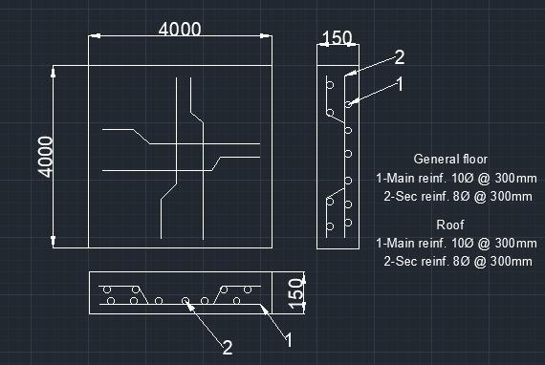
Slab Design (Manual)

Slide 48
Column Design

Slide 49
For Column:
From STAAD, load on one column (at basement level) = 15038kN
Area at base = 15038/30000 = 0.5013m^2
Column size at basement level = 0.708m
Taking column of 750mm x 750mm

Slide 50
For Column:
Design of (650 mm * 650 mm) column:
Compressive Force (P) = 135.64 KN Moments: Muy =0.34 Muz = 49.17KN.m
Clear cover = 40 mm
Here, we design a short column of square cross-section under biaxial bending:
Assuming the percentage of steel used (p) = 2.5%
Maximum compressive force on column (Pu) = 0.45 * fck * Ac + 0.75 * fy * Asc
= ( 0.45 * 30 * (650)^2 + 0.75 * 500 * (2.5/100) * (650)^2 ) * 10^(-3)
= 9664.68 KN
So, P / Pu = 135.64 / 9664.68 = 0.014 ⇒ α = 1.0
Now, d’ / D = (40 + 32/2 + 8) / 650 = 0.098
p / fck = 0.083 P / (fck * b * D) = 0.011
From the interaction diagram in SP - 16 : 1980:- (For d’ / D = 0.1 and fy = 500 MPa)
Mu / (fck * D * b^2) = 0.155
⇒ Muz1 = 1277 KN.m
Similarly, Muy1 = 1277 KN.m (Since it is a square cross-section)
Now, (Muy / Muy1) ^ α + (Muz / Muz1) ^ α < 1
So, (0.34 /1277) ^ 1 + (49.17 /1277) ^ 1 = 0.0387 < 1
Therefore, we can take 2.5% steel.

Slide 51
So, the Area of steel required = (2.5 / 100) * (650)^2 = 10562.5mm^2
Hence, we provide 14-32 φ bars as main reinforcement. For transverse reinforcement:
Considering 8 φ steel bars for transverse reinforcement:
According to IS: 456 - 2000, the spacing between the transverse reinforcement shall not
be more than sixteen times the smallest diameter of the longitudinal reinforcement tie bar
i.e., 16 * 32 = 512 mm or 300 mm
Hence, we provide 8 φ transverse reinforcement @ 300 mm c/c.
For Column:
Design of (750 mm * 750 mm) column:
Compressive Force (P) = 186.35 KN Moments: Muy =0.09 Muz = 97.56 KN.m
Clear cover = 40 mm
Here, we design a short column of square cross-section under biaxial bending:
Assuming the percentage of steel used (p) = 2.5%
Maximum compressive force on column (Pu) = 0.45 * fck * Ac + 0.75 * fy * Asc
= ( 0.45 * 30 * (750)^2 + 0.75 * 500 * (2.5/100) * (750)^2 ) * 10^(-3)
= 12867 KN
So, P / Pu = 186.35 / 12867 = 0.0144 ⇒ α = 1.0
Now, d’ / D = (40 + 32/2 + 8) / 750 = 0.088
p / fck = 0.083 P / (fck * b * D) = 0.011
From the interaction diagram in SP - 16 : 1980:- (For d’ / D = 0.1 and fy = 500 MPa)
Mu / (fck * D * b^2) = 0.155
⇒ Muz1 = 1277 KN.m

Slide 52
Similarly, Muy1 = 1277 KN.m (Since it is a square cross-section)
Now, (Muy / Muy1) ^ α + (Muz / Muz1) ^ α < 1
So, (0.09 / 1277) ^ 1 + (97.56 /1277) ^ 1 = 0.076 < 1
Therefore, we can take 2.5% steel.
So, the Area of steel required = (2.5 / 100) * (750)^2 = 14062.5mm^2
Hence, we provide 18-32 φ bars as main reinforcement. For transverse reinforcement:
Considering 8 φ steel bars for transverse reinforcement:
According to IS: 456 - 2000, the spacing between the transverse reinforcement shall not
be more than sixteen times the smallest diameter of the longitudinal reinforcement tie bar
i.e., 16 * 32 = 512 mm or 300 mm
Hence, we provide 8 φ transverse reinforcement @ 300 mm c/c.

Slide 53
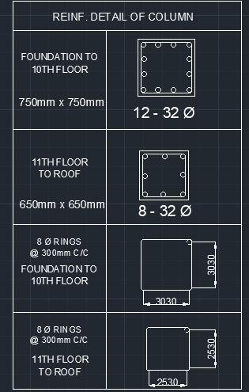

Slide 54
Foundation Design

Slide 55
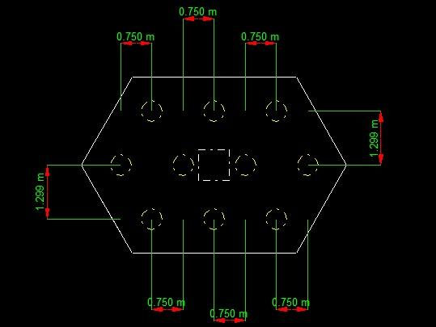

Slide 56
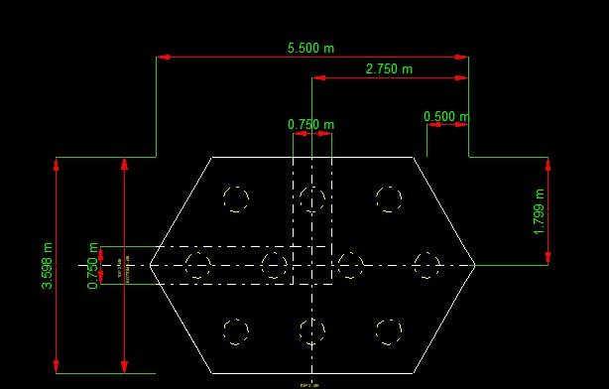

Slide 57
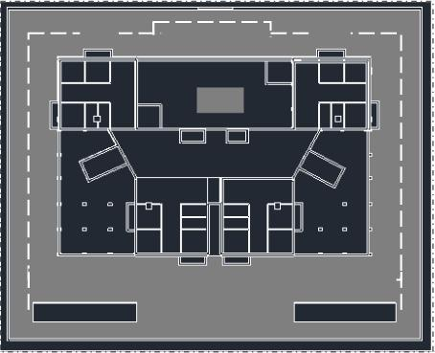
Road Network

Slide 58
Design of Shear Wall

Slide 59
Shear Wall
The thickness of the shear wall assumed is 200mm.
Maximum Drift Calculation
(After adding shear wall)
From Staad:-
Maximum deflection (δ) = 118.594 mm
Height of building (h) = 73.6 m
Maximum drift = δ/h
= 118.594/(73.6e3)
= 0.0016
As per IS 1893 (Part 1) - 2016 Cl. 7.11.1.1, Maximum drift ≤ 0.004
Therefore, the building is safe against deflection.

Slide 60
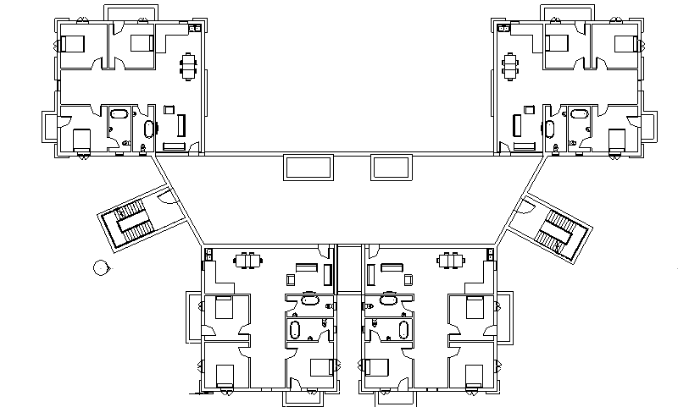

Slide 61
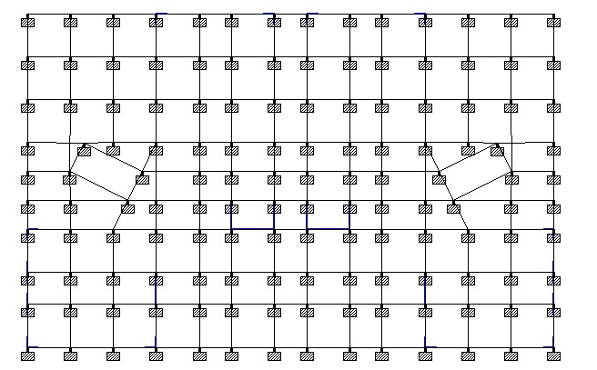

Slide 62
Quality and Cost Estimation
Concrete = 8371.3 cu. m
Steel = 7609760 N
Bricks = 37000
Cost in Noida:-
Concrete = Rs. 5000 / cu. m
Steel = Rs. 6.12 / N
Bricks = Rs. 6.6 / piece
Total cost (rounded to nearest 50)= Rs. 8,86,72,450/-

Slide 63
References
Model Building Bye-Law 2016
National Building Code of India 2016
IS 456-2000
IS 875 (Part 1, 2, 3)
IS 1893 - 2016
IS 13920 - 1993

